Slide 1




Efficient Discovery of Actual Causality using Abstraction-Refinement
What is the cause of this crash?
Arshia Rafieioskouei, Borzoo Banakdarpour
Trustworthy and Reliable Technologies LAB, Michigan State University
Notes:
Hi, thank you for attending to my talk
This is talk is practice for next week emsoft conference
So You feedback and comments help me a lot in this process

Slide 2







Motivation
pos(0) = 0.0
vel(0) = 0.02
action(0) = 1
pos(0) = 0.0
vel(0) = 0.02
action(0) = -1
Success
Research Question
Which of these control actions causes failure?
Failure
pos(1) = 0.02
vel(1) = 0.018
action(1) = 1
pos(1) = -0.01
vel(1) = -0.01
action(1) = -1
Action = 1
Action = -1
Correlation doesn’t mean Causation
Action = 0
pos(n-1) = 0.12
vel(n-1) = 0
action(n-1) = 1
pos(n-1) = 0.58
vel(n-1) = 0.05
action(n-1) = 1
-1.2
0
0.6
pos(n) = 0.11
vel(n) = -0.001
action(n) = 1
pos(n) = 0.6
vel(n) = 0.01
action(n) = 1
Classifier
G. Brockman, V. Cheung, L. Pettersson, J. Schneider, J. Schulman, J. Tang, and W. Zaremba, “OpenAI Gym,” 2016.
1/34
Notes:
(1)This is mountain Car env
(1)Highly usable in RL and CPS experiments
(1)action, pos, vel and the goal reach on top of mountain
(2)This is failure attempt that car could not reach top of the heal
(trace)This is the equevalent trace to the animation (pos , vel action )
(trace) to failure
(3)Our research question (which of the actions done by the controller lead to a failure)
(4,5) an option is to train a classifier to get the actions as feature and the result (failure, success) as labels
(6) But this has some drawbacks, I want mention the famous example of shark attack and ice-cream sale
(7) By looking at the behavoir of this two events can we say that ice-cream business is cause of shark attacks? Or maybe there is another event influencing on both of these two events which is summer as COFOUNDING FACTOR , There are other example in medecince were there is a relation between smoking and cancer (however there could be genom that both lead you to smoke and getting cancer)
(8) All of these examples lead us to look for causation not corrolation
(9) Imagine we have another scenario where car could reach to its goal
(traces) explain one by one
(10) By looking these two traces can we get something out of it. first 2 last ones which gives us nothing then second one They did diffrent actions but they are not in same states so we cant decide but look at state 1 were you are in same state one decide go left one decide go right. This could be a answer we are looking for.
I want to mathematically prove what is the casue of failure.

Slide 3



Objective
System Traces
Actual Cause of Failure
Failure
Safety Conditions
2/34
Notes:
We have bunch of system traces (logs, state action)
safety condition (in mountain car reaching to the goal is safety condition )
We found some of these traces violate these conditions and failed, we want to find out what was the ACTUAL CAUSE of this failure.

Slide 4

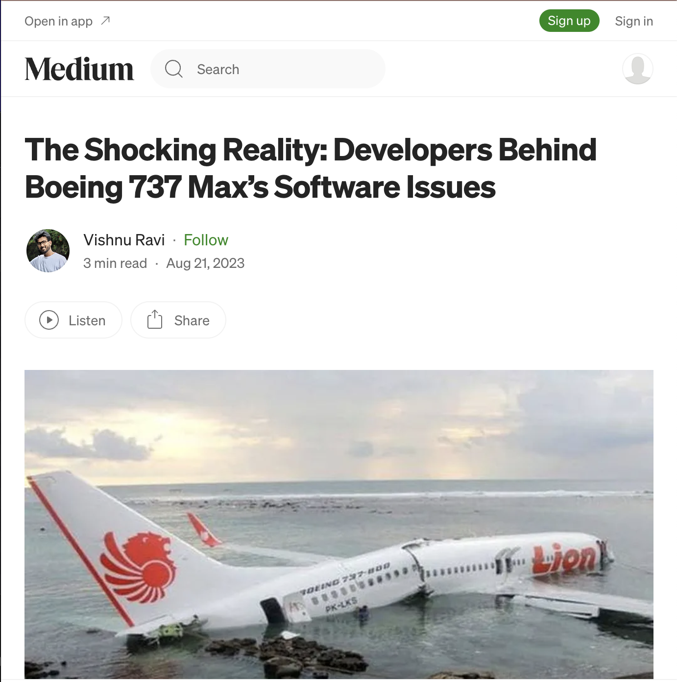
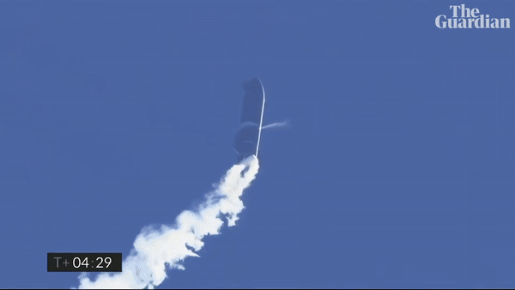
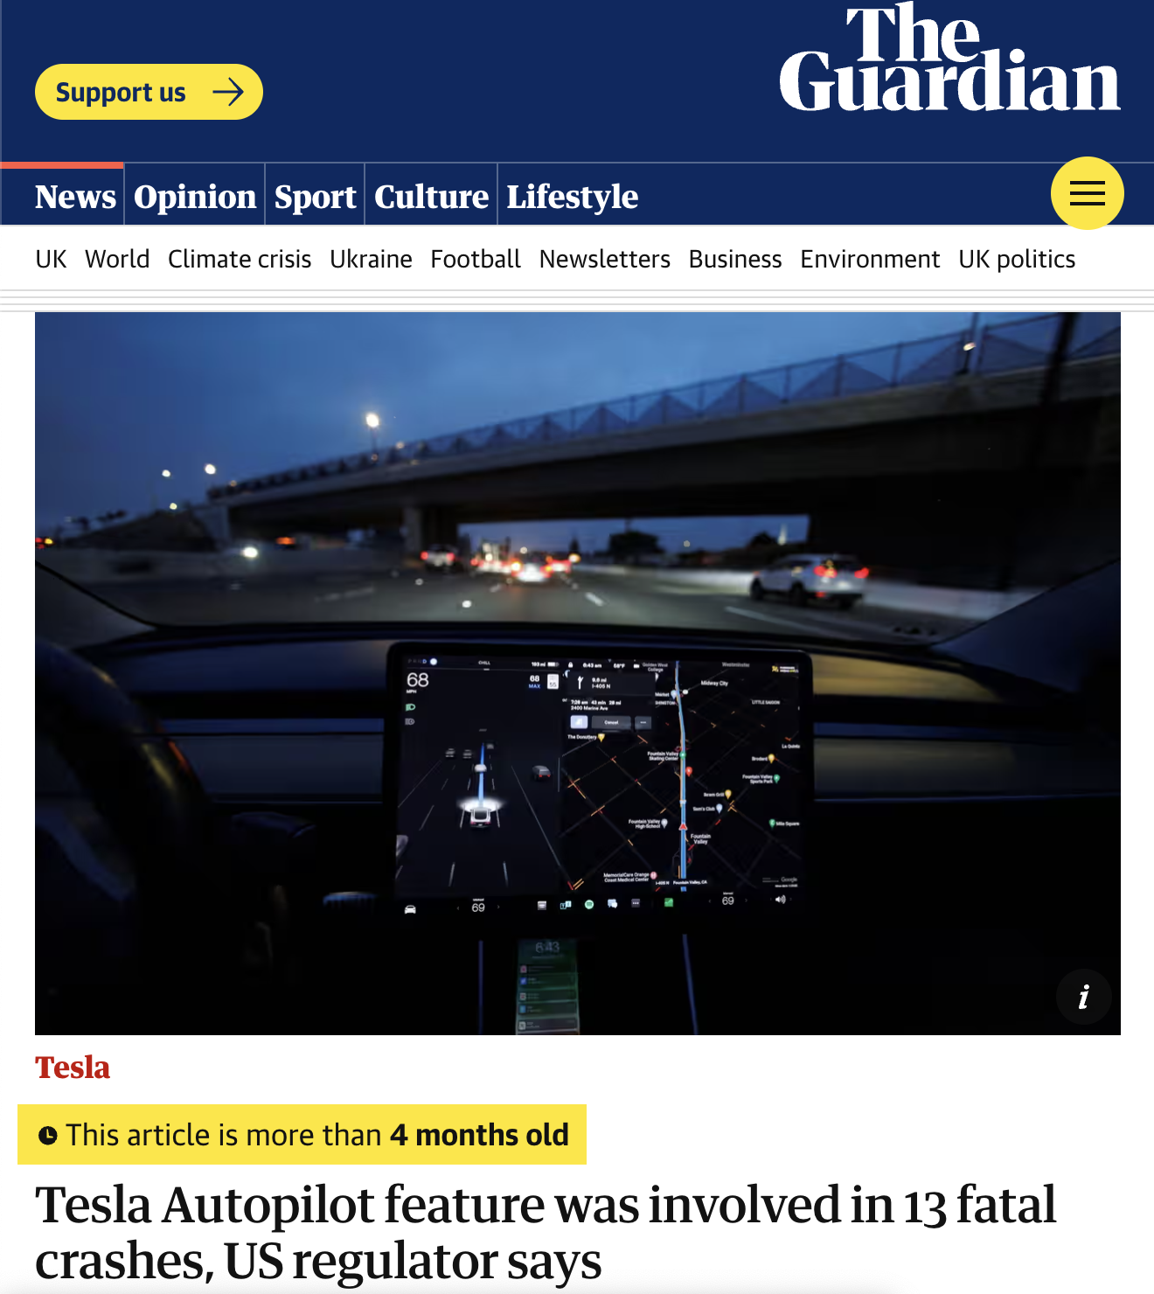
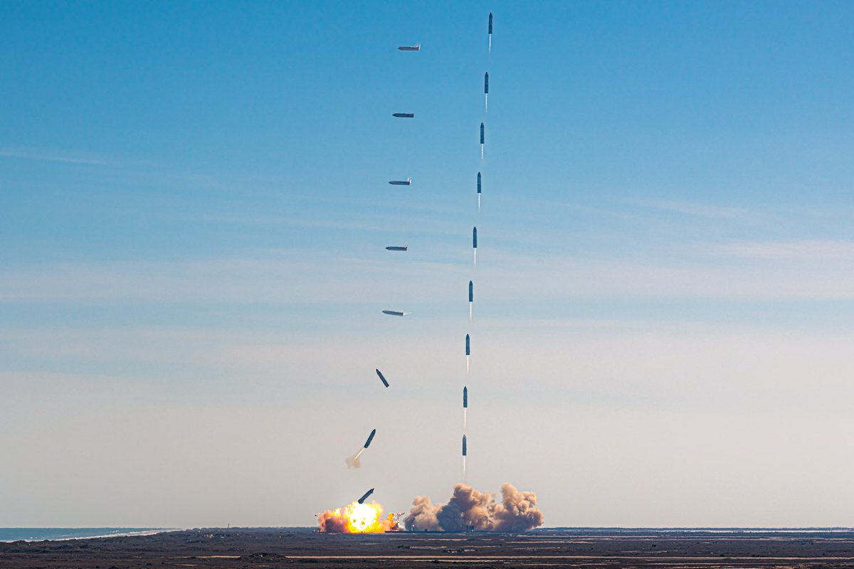
Applications
Aviation
Aerospace
Autonomy
Graphics by The Guardian, Medium and @johnkrausphotos
3/34
Notes:
- This research is about finding cause of failures
Our Interesting question is where we can apply this study?
- (1)One of the events happened in aivation industry were a software anti-stall MCAS system was cause the failure
-(2) Or spacex landers
-(3) Or tesla cars auto pilot

Slide 5
Outline
1
2
3
4
Causality
Approach
What is Causality?
How to find causal relations in CPS systems?
Experiments
Conclusion
Results and Causal Analysis.
Summary and Future Work.
4/34
Notes:
1- first we are going to talk about cauaslity, the defenitions we need
2- Our approach is how we can use these defenitions and find causal relations inside a CPS system?
3- Our results
4-we end up by the take aways and how we can extend it.

Slide 6
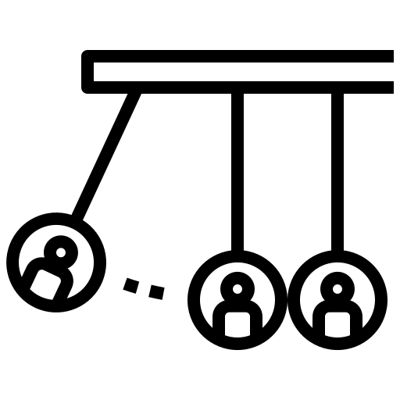
1
Causality
What is Causality?
Our Problem
What is Actual Causality?
5/34

Slide 7
Causality
Causality is the science of cause and effect.
Causality is the study of how things influence one other, how causes lead to effects. In the classical world we live in, it comes with a few basic assumptions.
Our Problem
How do we mathematically prove causal relation
between events in CPS?
6/34
Notes:
1- read
2- read
3- So our problem right now is we know what is cause and what is effect effect how we can mathmatically prove causal relation between events in Cyber physical systems.

Slide 8
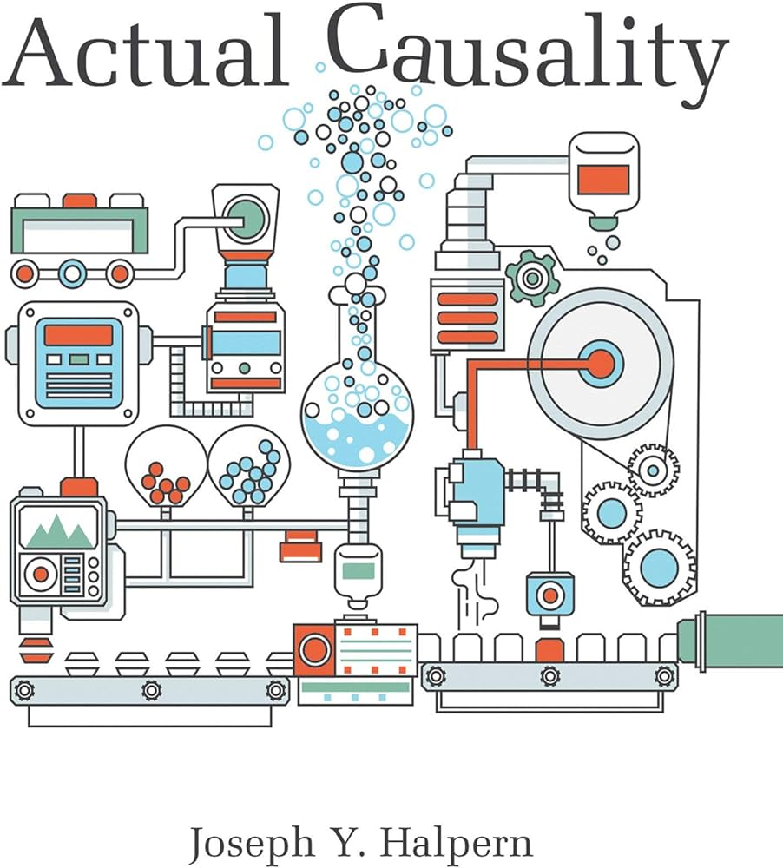


Actual Causality (Halpern & Pearl)
Based on counterfactual reasoning.
Why Actual Causality?
Token-level Causality
Type-level Causality
7/34
Notes:
We found this frame work Actual Causality introduced by Joseph Halpern and Juda Pearl .
This framework is based on counterfactual reasoning (I am going to explain what s counterfactual reasoning in next slide)
The question you might have is Why this framework why actual causality?
This notation focuses on token level causality which is the causal effect of particular events rather than type level causality which attempts to make general statements such as smoking causes cancer

Slide 9
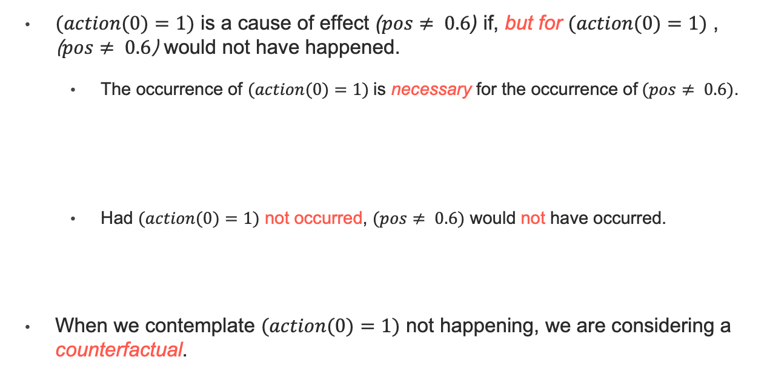
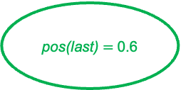
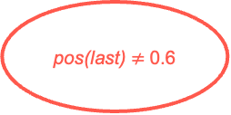
Actual Causality
pos(0) = 0.0
vel(0) = 0.02
action(0) = 1
pos(0) = 0.0
vel(0) = 0.02
action(0) = -1
$(action(0)=1)$ is a cause of effect ($pos≠ 0.6$) if, but for $(action(0)=1)$ , ($pos≠ 0.6$) would not have happened.
The occurrence of $(action(0)=1)$ is necessary for the occurrence of $(pos≠ 0.6)$.
Had $(action(0)=1)$ not occurred, $(pos≠ 0.6)$ would not have occurred.
When we contemplate $(action(0)=1)$ not happening, we are considering a counterfactual.
pos(1) = 0.02
vel(1) = 0.018
action(1) = 1
pos(1) = -0.01
vel(1) = -0.01
action(1) = -1
action(0) = 1
pos(last) $≠$0.6
pos(n-1) = 0.12
vel(n-1) = 0
action(n-1) = 1
pos(n-1) = 0.58
vel(n-1) = 0.05
action(n-1) = 1
action(0) = -1
pos(last) $=$0.6
pos(n) = 0.11
vel(n) = -0.001
action(n) = 1
pos(n) = 0.6
vel(n) = 0.01
action(n) = 1
8/34
Notes:
Lets recall the traces we have in our slide where one lead to failure and other one lead to success
In Our definition we say first action which is going forward is cause of failure (not reaching .6) then read
From this ststement we can extract two statements.
read explain
read explain
When we say action =1 not happened and somthing else happned we are talking about counterfacual.

Slide 10
Actual Causality ( HP Conditions )
We have a causal relation when the cause and effect satisfy these conditions:
AC1: Both the cause and effect occur.
AC2(a): Changing the cause to a counterfactual setting will result in the effect not occurring.
AC2(b): If the cause occurs, any changes in unrelated variables will not prevent the effect from happening.
AC3: The set of causes must be minimal.
9/34
Notes:
To be more formilize we say we have a caual rela tion when sat these conditions
read
main job happening in ac2
read
read

Slide 11
Causal Setting
HP Framework
Causal Model
Signature
Variables Exogenous
Endogenous
Domains
Structural Equations
10/34
Notes:
Also This framework has a setting which consist of Structural equations and Causal Model
New Thing
execuations not equations
not convient way to reason about CPS

Slide 12
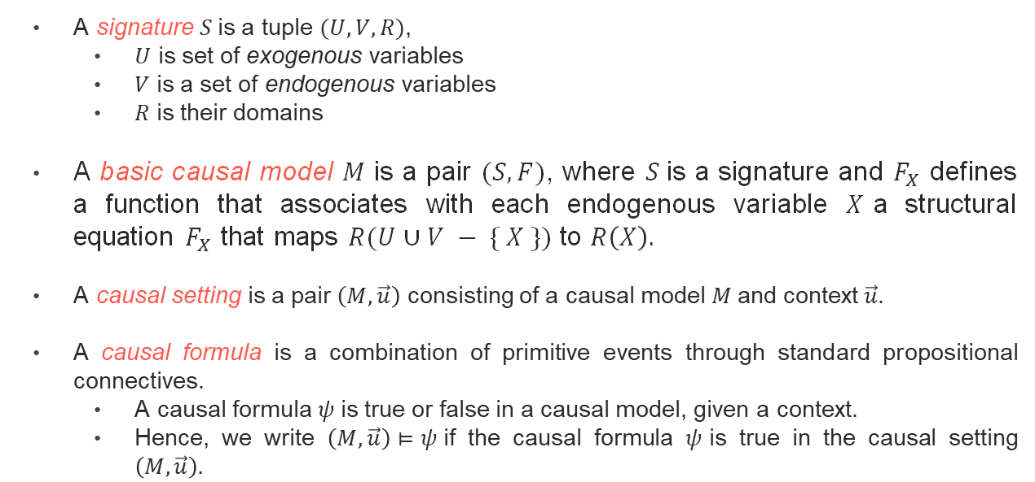
Causal Setting
A signature $S$is a tuple $(U,V,R)$,
$U$ is set of exogenous variables
$V$ is a set of endogenous variables
$R$ is their domains
A basic causal model $M$ is a pair $(S,F)$, where $S$is a signature and $F_{X}$ defines a function that associates with each endogenous variable $X$a structural equation $F_{X}$ that maps $R(U∪V − \{ X \})$ to $R\left(X\right).$
A causal setting is a pair $\left(M,\vec{u}\right)$ consisting of a causal model $M$and context$\vec{u}$.
A causal formula is a combination of primitive events through standard propositional connectives.
A causal formula $ψ$is true or false in a causal model, given a context.
Hence, we write $\left(M,\vec{u}\right)⊨ψ$if the causal formula $ψ$is true in the causal setting $\left(M,\vec{u}\right).$
Notes:
So F_{X} determines the value of X, given the values of all the other variables in U ∪ V.

Slide 13
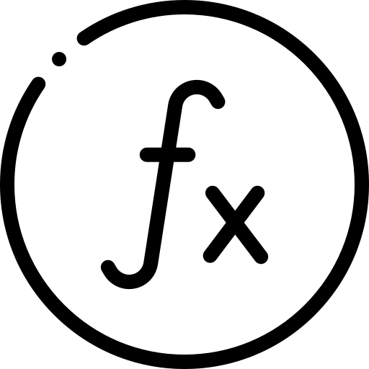



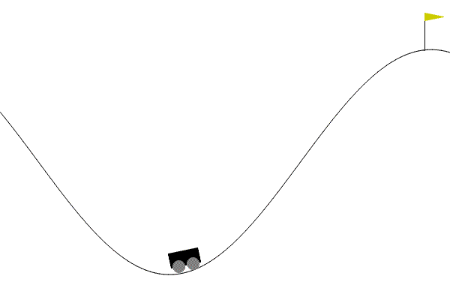



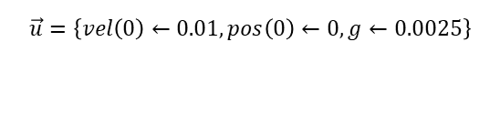
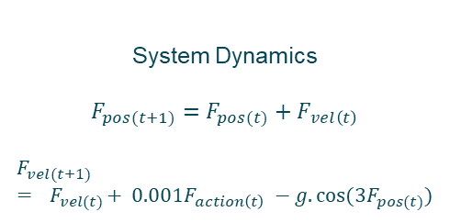



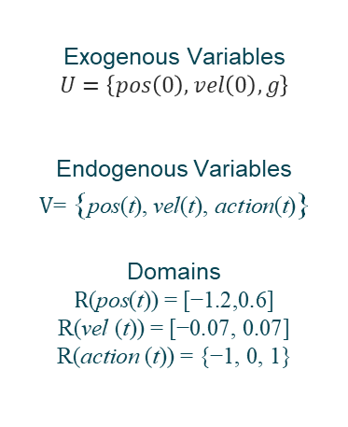
Causal Setting (Example)
Signature $(U,V,R)$
Function $F_{X}$
Causal Formula
Exogenous Variables
$$U=\left\{pos\left(0\right),vel\left(0\right),g\right\}$$
Endogenous Variables
$$\text{V}\text{= }\text{\{}\text{pos}\text{(}\text{t}\text{), }\text{vel}\text{(}\text{t}\text{), }\text{action}\text{(}\text{t}\text{)}\text{\}}$$
Domains
$$\text{R}\text{(}\text{pos}\text{(}\text{t}\text{)) = [−1.2,0.6]}$$
$$\text{R}\text{(}\text{vel}\text{ (}\text{t}\text{)) = [−0.07, 0.07]}$$
$$\text{R}\text{(}\text{action}\text{ (}\text{t}\text{)) = \{−1, 0, 1\}}$$
System Dynamics
$F_{pos(t+1)}=F_{pos(t)}+F_{vel\left(t\right)}$
$$F_{vel(t+1)}={ F}_{vel(t)}+ 0.001F_{action\left(t\right)} −g.cos⁡(3F_{pos(t)})$$
$$φ_{fail}≜\text{ (}\text{pos}\text{(}\text{n}\text{) }≠0.6\text{) }$$
Context $\vec{u}$
$$\vec{u}=\left\{vel\left(0\right)←0.01, pos\left(0\right)←0, g←0.0025\right\}$$
G. Brockman, V. Cheung, L. Pettersson, J. Schneider, J. Schulman, J. Tang, and W. Zaremba, “OpenAI Gym,” 2016.

Slide 14
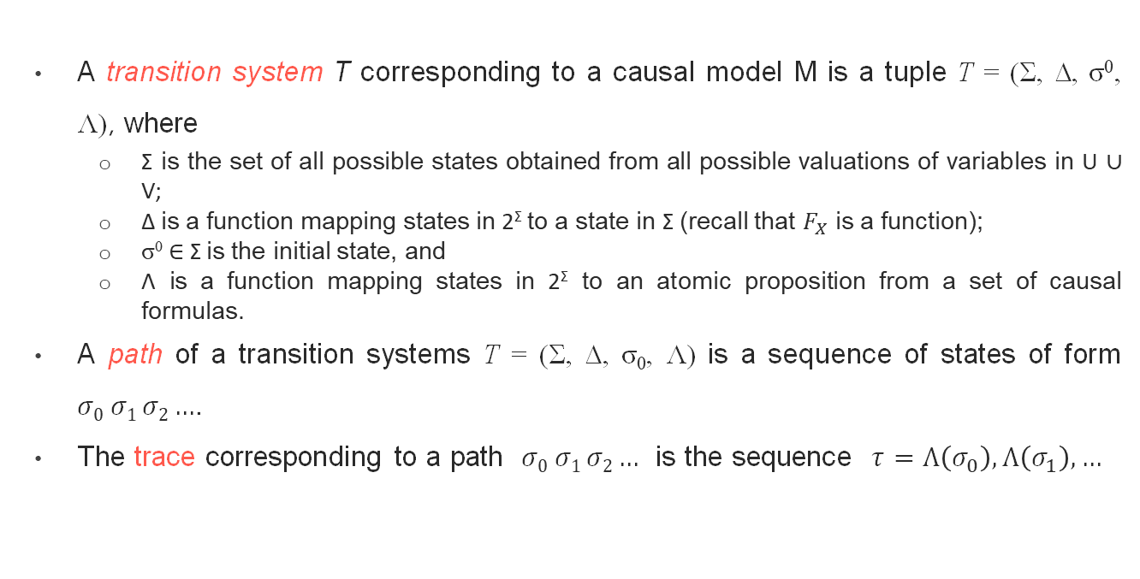
Transition Systems
A transition system T corresponding to a causal model M is a tuple T = (Σ, ∆, σ⁰, Λ), where
Σ is the set of all possible states obtained from all possible valuations of variables in U ∪ V;
∆ is a function mapping states in 2^{Σ} to a state in Σ (recall that $F_{X}$ is a function);
σ⁰ ∈ Σ is the initial state, and
Λ is a function mapping states in 2^{Σ} to an atomic proposition from a set of causal formulas.
A path of a transition systems T = (Σ, ∆, σ₀, Λ) is a sequence of states of form $σ0 σ1 σ2…$.
The trace corresponding to a path $σ0 σ1 σ2…$ is the sequence $τ=Λ\left(σ_{0}\right),Λ\left(σ_{1}\right),…$

Slide 15

2
Approach
Discovery of Actual Cause
Under/Over Approximation
Abstraction-Refinement Approach
Soundness of the Algorithm
11/34
Notes:
Now we know what is actual causality, however we don’t know how to discover the cause in a CPS system.
In this section we look for this goal.

Slide 16

Discovery of Actual Cause
Causal Model
Yes (+witness)
HP Constraints
No
12/34
Notes:
My problem right now is getting the causal model and the HP constraints and see whether I can find a cause or not.

Slide 17


Modified Framework
Causal Model
Transition Systems
More Operational
HP Constraints
SMT Constraints
13/34
Notes:
But what we have till now was definitions and nothing operational we can use to discover the actual cause so we need some modification.
Casual model to transition systems
HP Constraints to SMT constraints

Slide 18
Transition Systems
Initial state
Trace
Labeling Function
Path
Transitions
States
pos(0) = 0.1
vel(0) = 0.02
action(0) = 1
pos(1) = 0.2
vel(1) = 0.018
action(1) = 1
pos(n-1) = 0.5
vel(n-1) = 0
action(n-1) = 1
pos(n) = 0.4
pel(n) = -0.01
action(n) = 1
‘Not done’
‘Not done’
‘Not done’
‘Done failed’
14/34
Notes:
I want to explain the transition systems with our running example , Remember mounatin car scenario where we have states
transition
initial state
A function that map atomic proposition (basic statements) to states called labeling function
Seq of states is path
Seq of ap are tarces

Slide 19
SMT Constraints
AC1:
There exists a trace where the effect does not occur until the cause happens.
AC2(a):
There exists a trace where the cause and effect are not happening, while the trace we find here and in AC1 are either not equivalent in the causal path or unrelated variables.
AC2(b):
For all traces where the cause happens and the causal path remains in its actual context, even if we change the unrelated variables, we will eventually see the effect.
AC2(b):
15/34
Notes:
We formulate SMT constraints using LTL formulation
Don’t worry about this terms
highlite exist

Slide 20
SMT Based Discovery of Actual Cause
Transition Systems
Causal Model
Yes (+witness)
SMT Constraints
HP Constraints
No
SMT Solver
DP-Complete!
Aleksandrowicz, G., Chockler, H., Halpern, J.Y. and Ivrii, A., 2017. The computational complexity of structure-based causality. Journal of Artificial Intelligence Research, 58, pp.431-451.
16/34
Notes:
So now we can modify our discovery to MST based discovery
tried this however the results were not satisfiebale

Slide 21
Complexity of Actual Causality
Aleksandrowicz et al.¹ established that the problem of determining causality is DP-complete.
Aleksandrowicz, G., Chockler, H., Halpern, J.Y. and Ivrii, A., 2017. The computational complexity of structure-based causality. Journal of Artificial Intelligence Research, 58, pp.431-451.
18/34
Notes:
We provided the solver with the transition system, constraints, and the effect (which is the failure), and asked the solver to identify the cause as an uninterpreted function.
We solve this problem.
But it was not scalable
Also solving causality is Dp-complete problem
More efficient approach needed
get rid of this except teh third bullet point
large number of traces

Slide 22

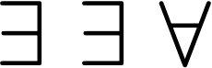




Our Idea
Over-Approximation $\hat{𝓣}$
AC2(b) : $∀ τ^{′′}$
Concrete Model $𝓣$
Under-Approximation $\check{𝓣}$
AC2(a) : $∃τ.∃ τ^{′′}$
19/34
Notes:
To address the scalebity issue I want to use these terms
Imagine we have the concerete model and recall the SMT constarnts we have it had a from of EEA
To reason about existential conditions we can use under approximate which take a subset of tarces and try to find these desirable traces in them
Forall -> verification -> we ca do over-approximation
Our idea as the titile

Slide 23
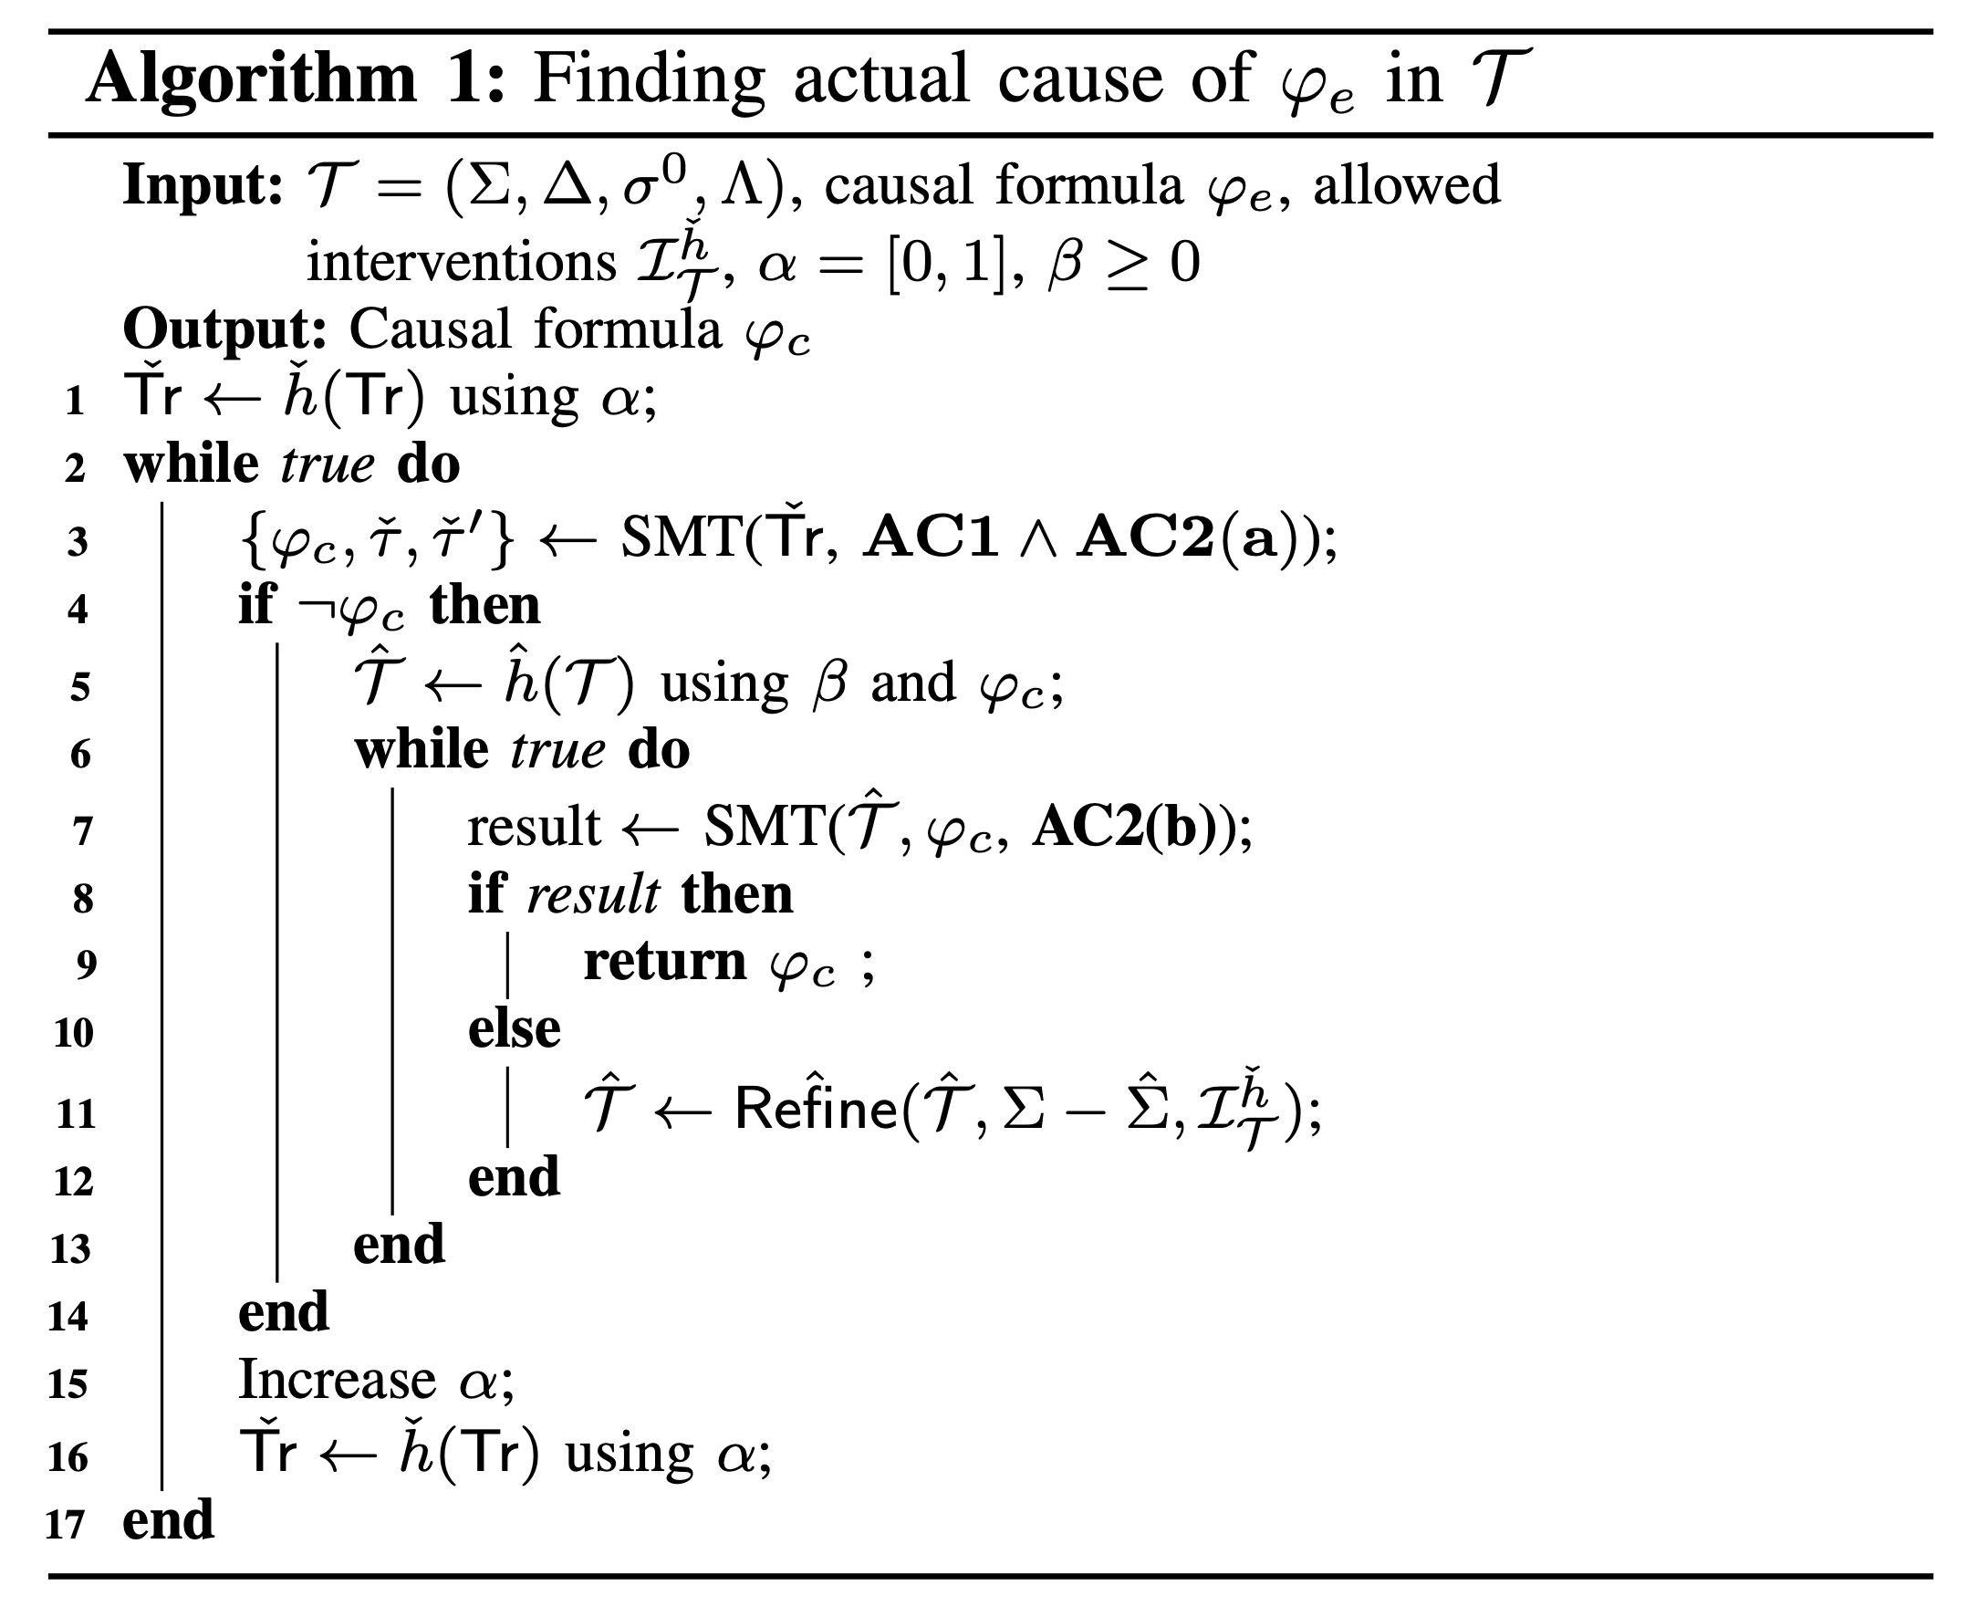
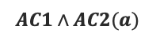
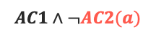
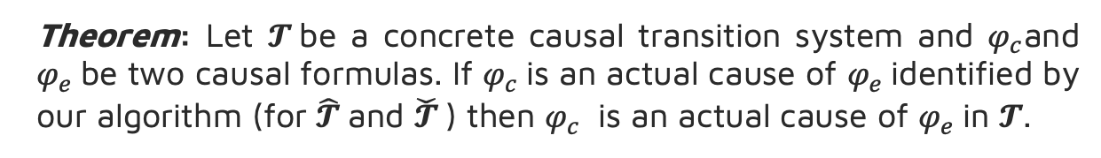
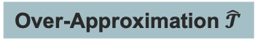
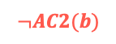
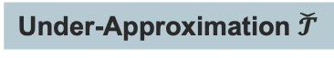
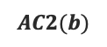
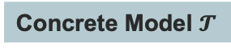
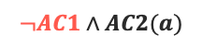
Abstraction-Refinement Algorithm
Concrete Model $𝓣$
Under-Approximation $\check{𝓣}$
refine
refine
$$AC1∧¬AC2(a)$$
$$¬AC1∧AC2(a)$$
$$AC1∧AC2(a)$$
refine
$$AC2(b)$$
Over-Approximation $\hat{𝓣}$
$$¬AC2(b)$$
CAUSE FOUND!
Theorem: Let $𝓣$be a concrete causal transition system and $φ_{c}$and $φ_{e}$be two causal formulas. If $φ_{c}$is an actual cause of $φ_{e}$identified by our algorithm (for $\hat{𝓣}$and $\check{𝓣}$) then $φ_{c}$ is an actual cause of $φ_{e}$in $𝓣$.
20/34
Notes:
actual cause found

Slide 24

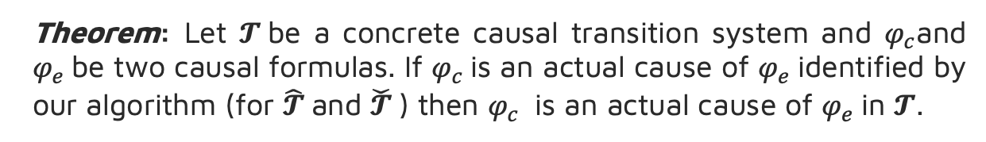
Soundness of the Algorithm
Theorem: Let $𝓣$be a concrete causal transition system and $φ_{c}$and $φ_{e}$be two causal formulas. If $φ_{c}$is an actual cause of $φ_{e}$identified by our algorithm (for $\hat{𝓣}$and $\check{𝓣}$) then $φ_{c}$ is an actual cause of $φ_{e}$in $𝓣$.
21/34
Notes:
ALSO this algorithm is sound meaning that the casue we found in the abstarction model is the actual cause in the cocrete model as well.

Slide 25

3
Experiments
How efficient is our algorithm?
How does causal analysis help in preventing failures?
22/34

Slide 26
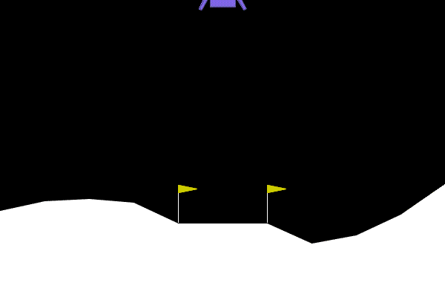
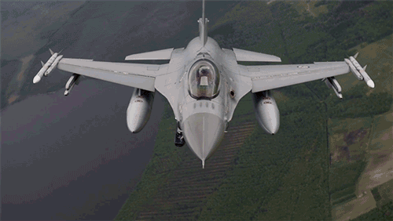
Case Studies
AI-Controller
Non AI-Controller
Mountain Car
Lunar Lander
F-16 Autopilot Simulator
G. Brockman, V. Cheung, L. Pettersson, J. Schneider, J. Schulman, J. Tang, and W. Zaremba, “OpenAI Gym,” 2016.
P. Heidlauf, A. Collins, M. Bolender, and S. Bak, “Verification challenges in F-16 ground collision avoidance and other automated maneuvers,” in ARCH18. 5th International Workshop on Applied Verification of Continuous and Hybrid Systems
23/34
Notes:
FIND ACTUAL CAUSE OF FAILURE
Two types of case studies

Slide 27
Implementation
Abstraction Model | Concrete Model
Abs_Z3: Using Z3 as the Solver | Only_Z3: Using Z3 as the Solver
Abs_DA: Using search algorithms in lieu of a solver | Only_DA: Using search algorithms in lieu of a solver
24/34
Notes:
Compare abstartion model with concerete model
Each of these models implemented in two ways using z3 as solver and one using just searching methods instead of solver

Slide 28
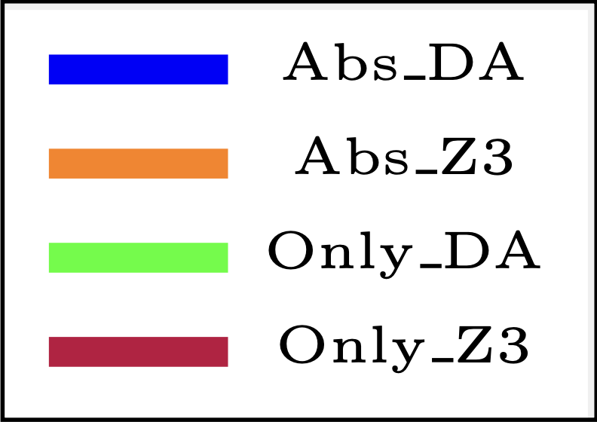
Case Study (1): Mountain Car
25/34
Notes:
We have talked about mountain car as running example a lot in this presentation.
We feed different number of of traces including traces lead to failure and success and ask the model to find the cause as you can seen the abstracted models perform much faster in order of magnitude

Slide 29
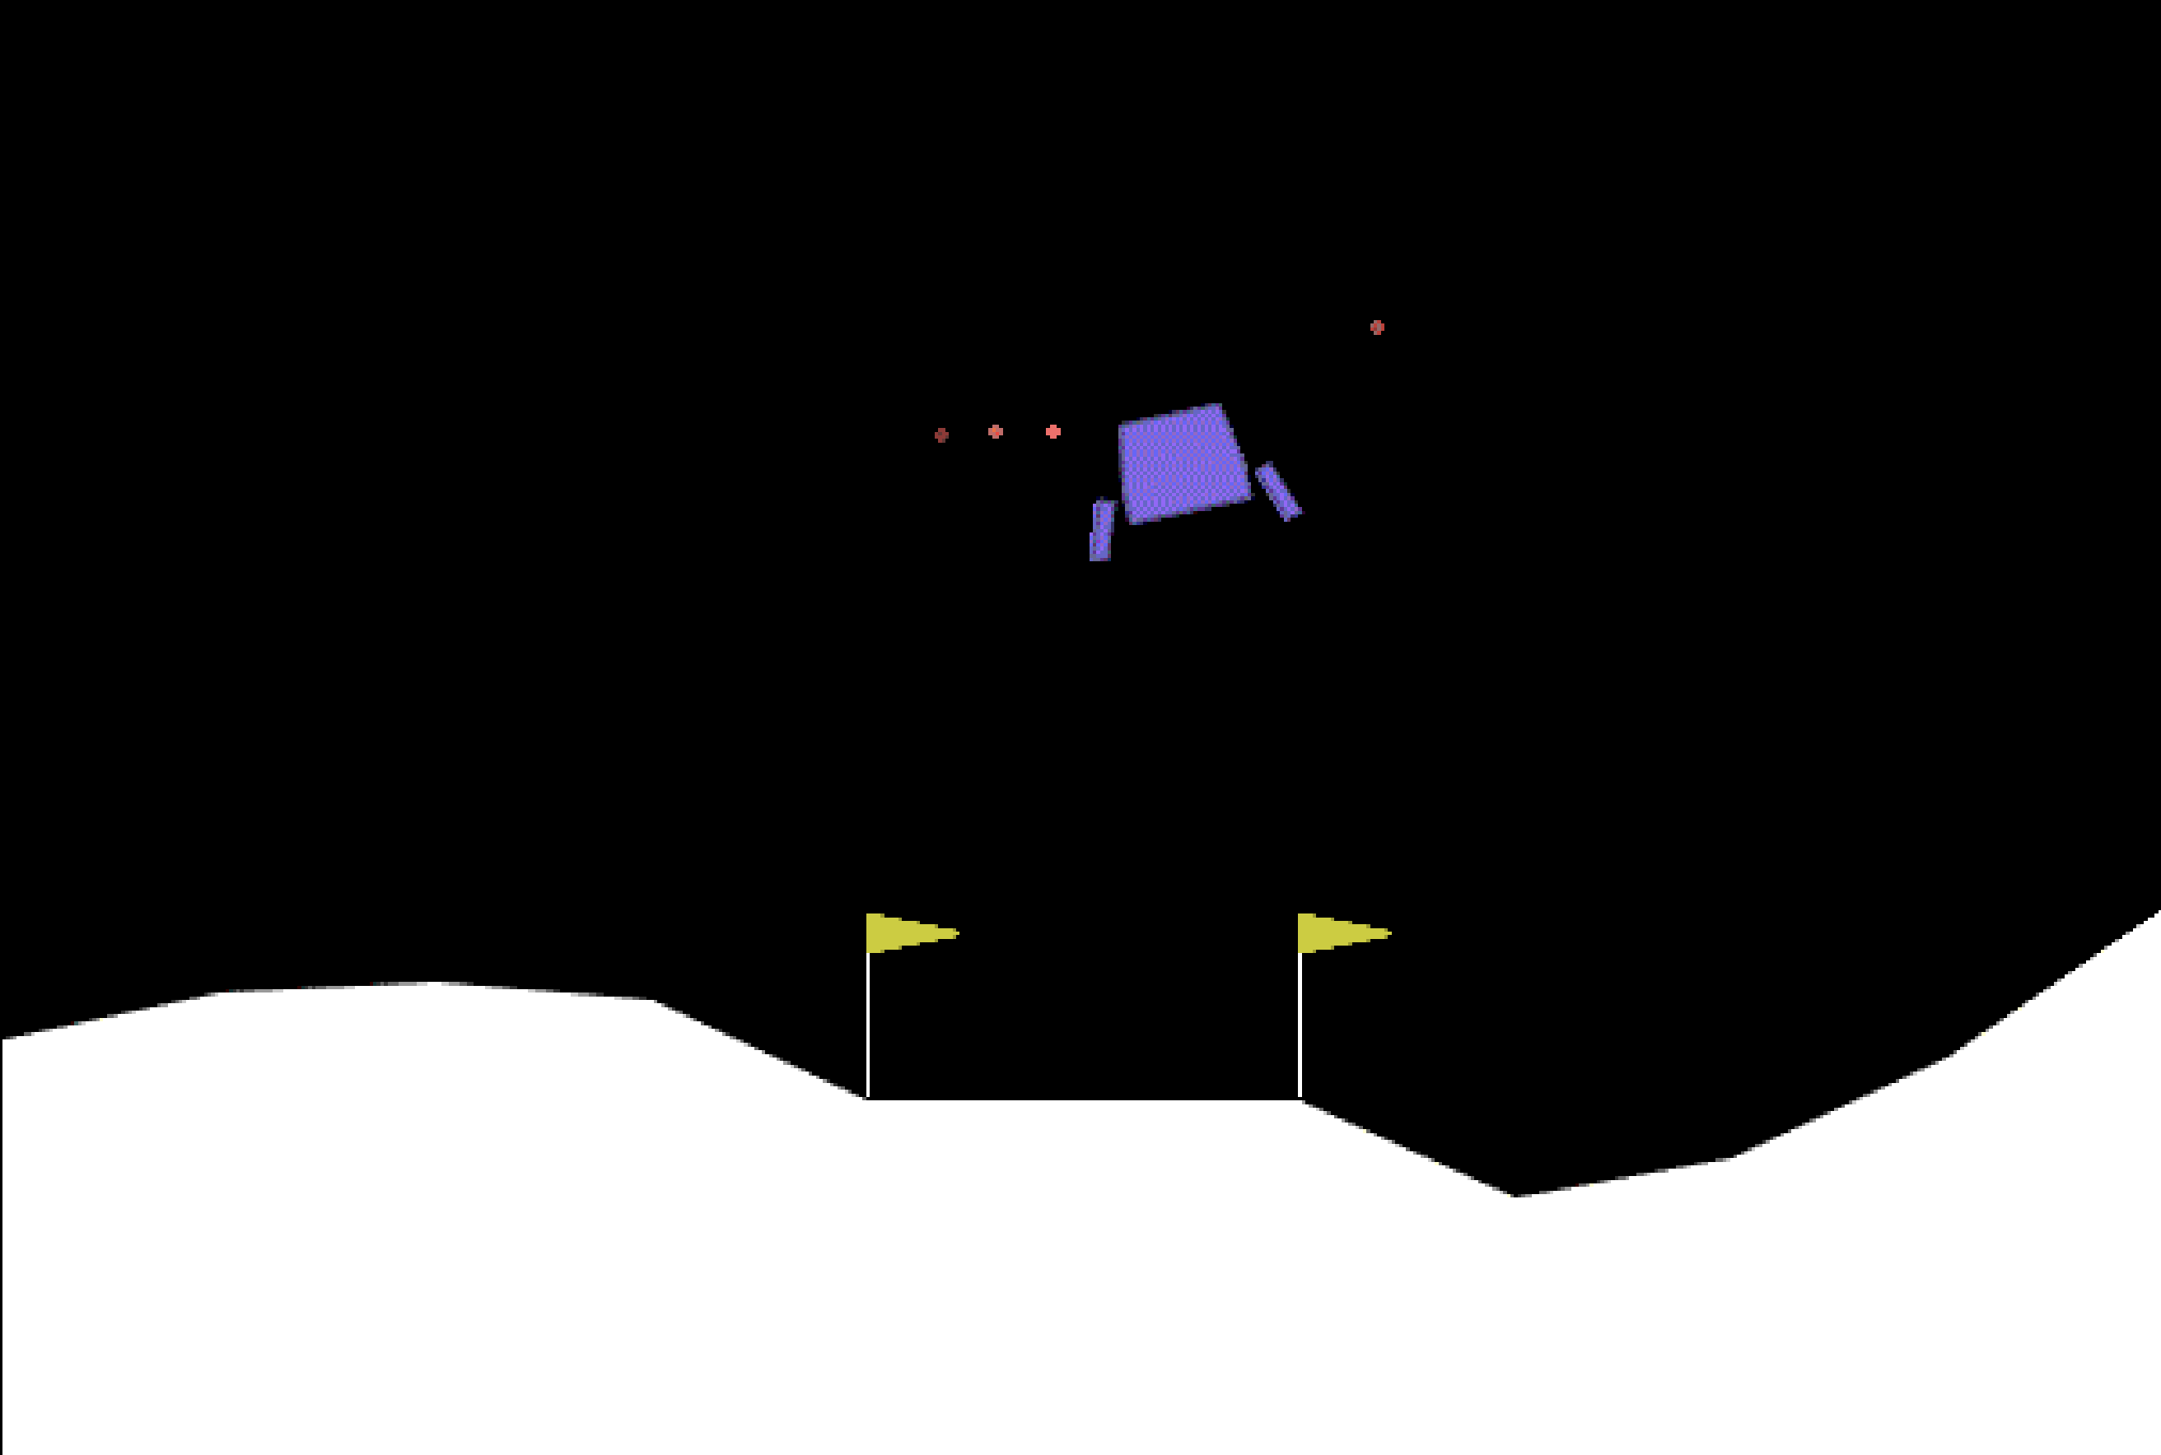


Case Study : Lunar Lander
Lunar Lander has more variables compared to Mountain Car.
Horizontal and vertical position velocity, angle.
Additional environmental variables such as wind, gravity, and turbulence power.
Expanded action space: main engine, left engine, right engine, and standby.
wind
Gravity
G. Brockman, V. Cheung, L. Pettersson, J. Schneider, J. Schulman, J. Tang, and W. Zaremba, “OpenAI Gym,” 2016.
26/34

Slide 30
Case Study : Lunar Lander
Timeout!
Timeout!
27/34
Notes:
Traces no and Time out

Slide 31
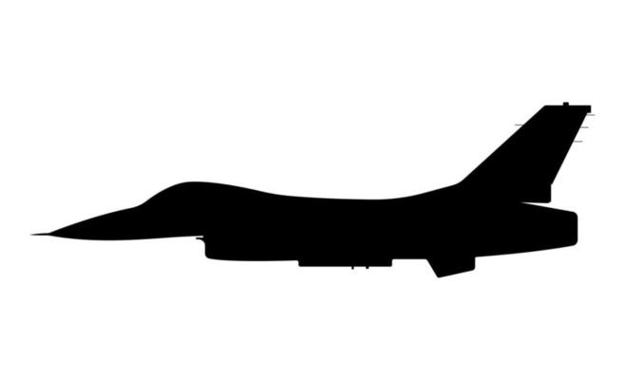
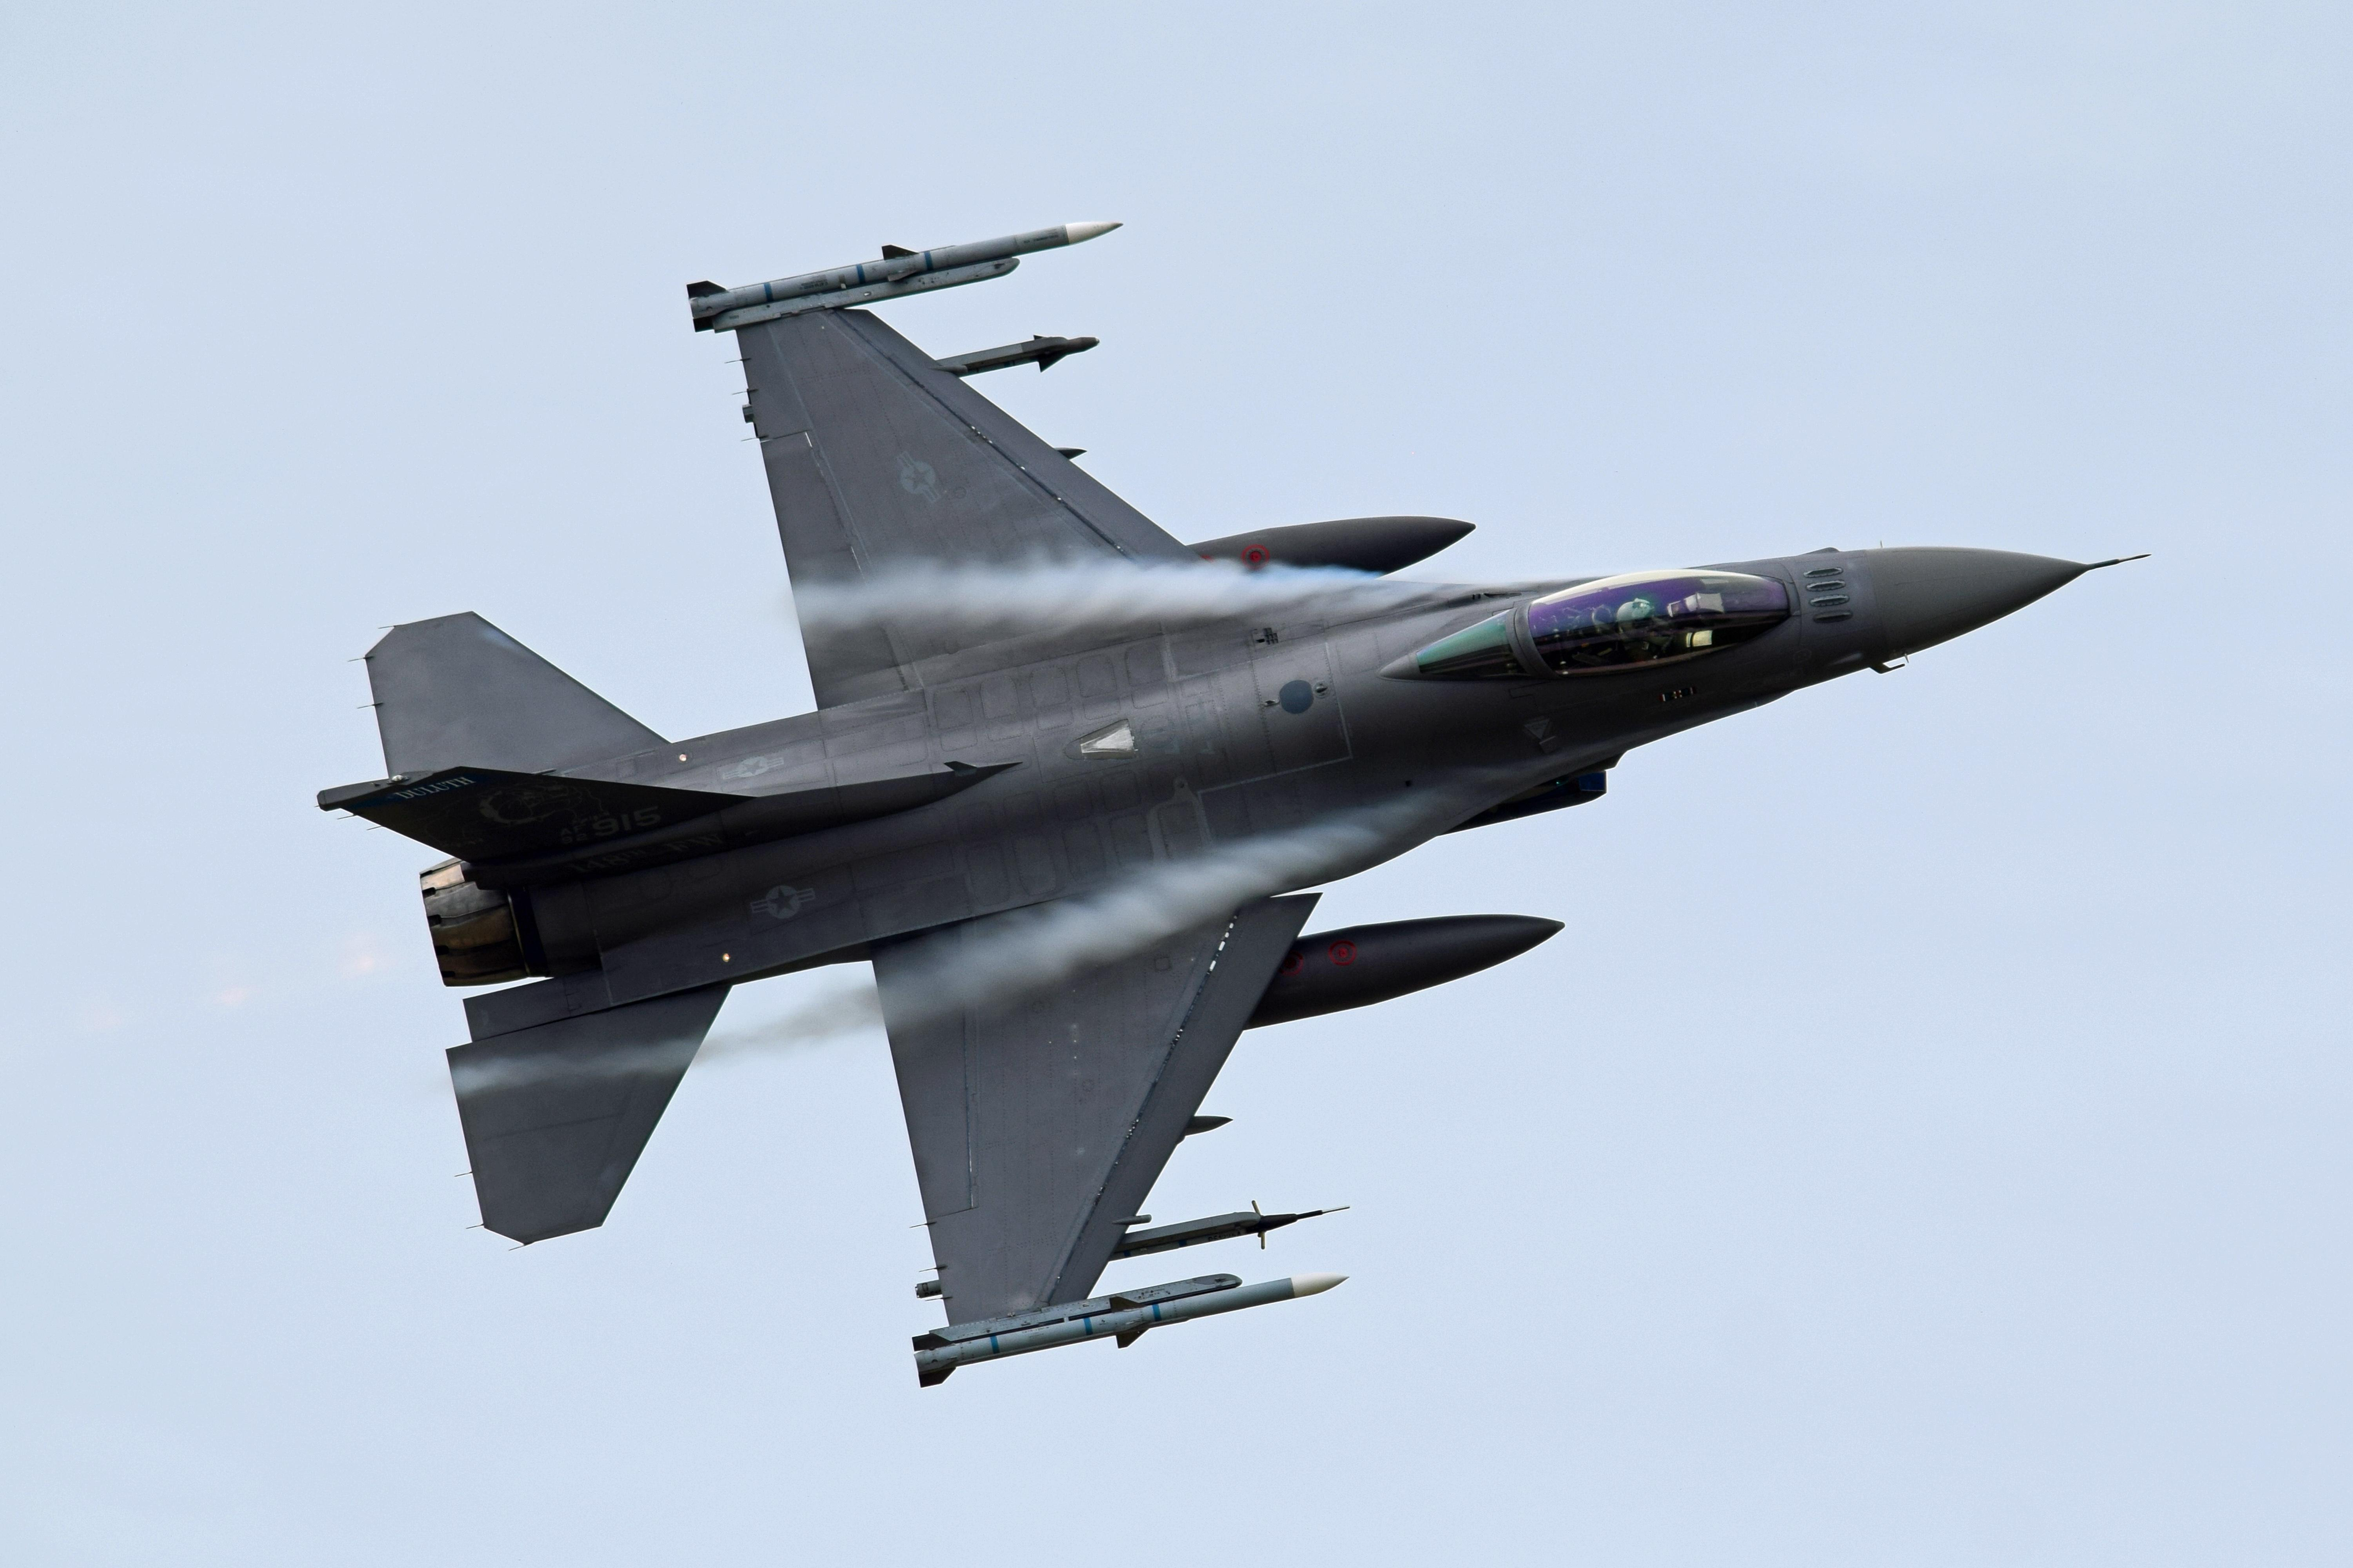
Case Study : F-16 Autopilot Simulator
First Scenario: The F-16 autopilot attempts to adjust the altitude within a specific timeline.
State Space: Altitude, airspeed, pitch, AoA, and power–lag
Action space: Adjusting the throttle and changing the elevators.
Angle of Pitch
Angle of Attack
Flight path
P. Heidlauf, A. Collins, M. Bolender, and S. Bak, “Verification challenges in F-16 ground collision avoidance and other automated maneuvers,” in ARCH18. 5th International Workshop on Applied Verification of Continuous and Hybrid Systems
28/34
Notes:
Two scenarios
autopilot

Slide 32
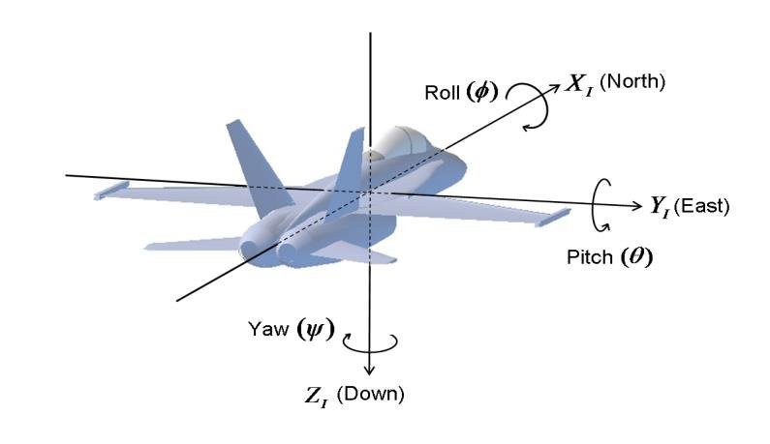
Case Study : F-16 Autopilot Simulator
Second Scenario: Place the aircraft in a critical position near the ground to evaluate whether its collision avoidance system can successfully recover.
Additional space states include yaw and roll.
Expanded action space: adjusting degree of rudder and aileron.
P. Heidlauf, A. Collins, M. Bolender, and S. Bak, “Verification challenges in F-16 ground collision avoidance and other automated maneuvers,” in ARCH18. 5th International Workshop on Applied Verification of Continuous and Hybrid Systems
29/34
Notes:
Rudder -> yaw
Aileron -> roll

Slide 33
Case Study : F-16 Autopilot Simulator
First Scenario
Second Scenario
30/34

Slide 34
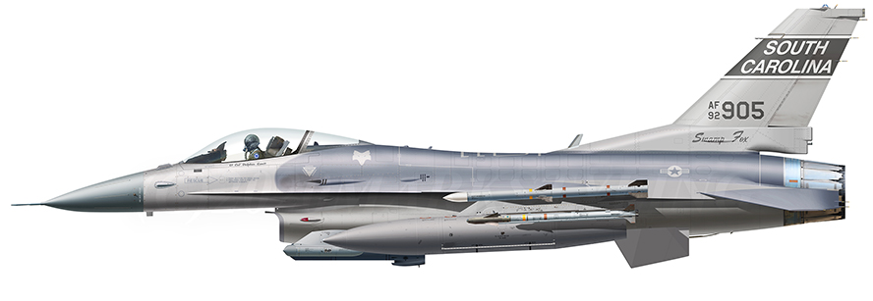
Causal Analysis
Alt(ft)
Alt(ft)
Vel
411
Vel
500
Vel
489
Vel
430
Vel
381
Vel
407
Vel
492
Vel
500
Vel
394
Vel
422
Vel
410
Vel
414
Vel
421
Vel
410
1850
AoA Violation
AoA
0
AoA
17
AoA
5
AoA
-17
AoA
17
AoA
11
AoA
0
AoA
0
AoA
0
AoA
0
AoA
-2
AoA
-5
AoA
-10
AoA
0
Trotl
0.0
Trotl
0.0
Trotl
1.0
Trotl
1.0
Trotl
1.0
Trotl
1.0
Trotl
0.64
Trotl
1.0
Trotl
1.0
Trotl
1.0
Trotl
1.0
Trotl
1.0
Trotl
1.0
Trotl
1.0
Elevt
-6
Elevt
-12
Elevt
10
Elevt
25
Elevt
-25
Elevt
-6
Elevt
25
Elevt
25
Elevt-1
Elevt
-0.5
Elevt
-2
Elevt
-6
Elevt
-6
Elevt
-0.5
1450
0
2
4
6
8
0
2
4
6
8
10
31/34
Notes:
One of the key aspects of this study is how finding cause help us prevent future failure

Slide 35

4
Conclusion
Summary
Future Works!
32/34

Slide 36
Summary
Actual causality enables us to explain the root cause of events.
SMT encoding to discover the actual cause of events in a transition systems.
An abstraction-refinement method to cope with the computational complexity.
Case studies in the CPS domain (with both AI and non-AI controllers) demonstrated the efficiency of the abstraction-refinement technique.
33/34

Slide 37



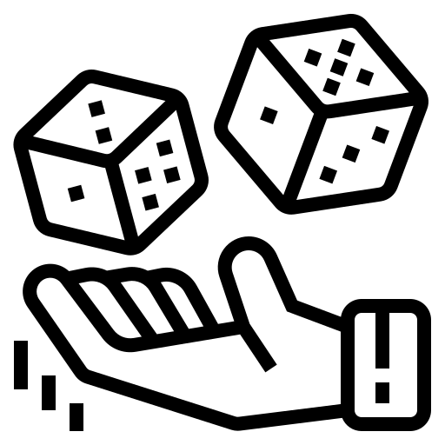



Future Work
Noisy Systems
Medical Science
Unknowns
Actual
Causality
Probabilistic
Causality
Law
34/34

Slide 38





Thanks! Any Questions?
Paper
Artifacts
TART@MSU
Contact

